Slide 1
Lower Extremity Trauma
Femur Fractures
Patella Fractures
Knee Dislocations
Tibia Fractures
Ankle Fractures

Slide 2
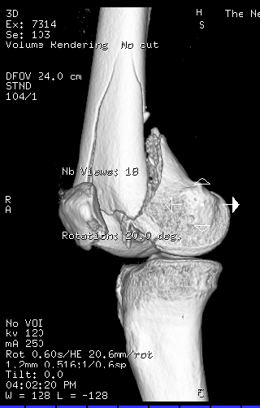
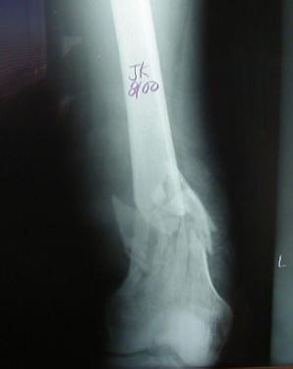
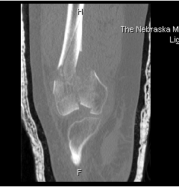
Distal Femur Fractures
Distal Metaphyseal Fractures
Look for intra-articular involvement
Plain films
CT

Slide 3
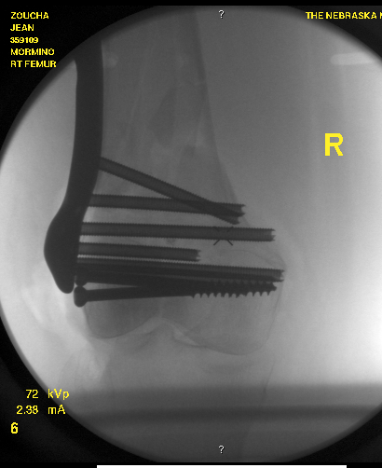
Distal Femur Fractures
Treatment:
Retrograde IM Nail
ORIF open vs. MIPO
Above depends on fracture type, bone quality, and fracture location

Slide 4
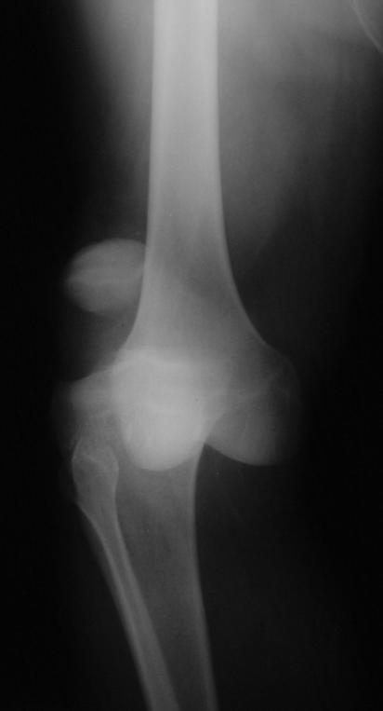
Knee Dislocations
High association of injuries
Ligamentous Injury
ACL, PCL, Posterolateral Corner
LCL, MCL
Vascular Injury
Intimal tear vs. Disruption
Obtain ABI’s → (+) → Arteriogram
Vascular surgery consult with repair within 6hrs
Peroneal >> Tibial N. injury

Slide 5
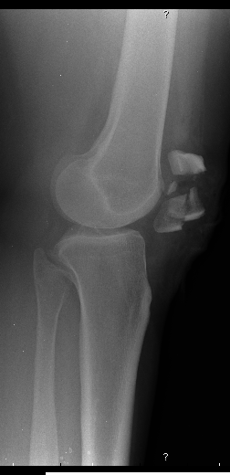
Patella Fractures
History
MVA, fall onto knee, eccentric loading
Physical Exam
Ability to perform straight leg raise against gravity (ie, extensor mechanism still intact?)
Pain, swelling, contusions, lacerations and/or abrasions at the site of injury
Palpable defect

Slide 6
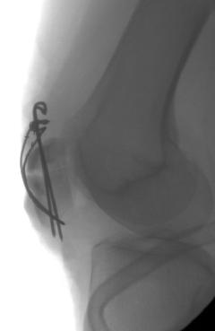
Patella Fractures
Radiographs
AP/Lateral/Skyline views
Treatment
ORIF if ext mechanism is incompetent
Non-operative treatment with brace if ext mechanism remains intact

Slide 7
Tibia Fractures
Proximal Tibia Fractures (Tibial Plateau)
Tibial Shaft Fractures
Distal Tibia Fractures (Tibial Pilon/Plafond)

Slide 8
Tibial Plateau Fractures
MVA, fall from height, sporting injuries
Mechanism and energy of injury plays a major role in determining orthopedic care
Examine soft tissues, neurologic exam (peroneal N.), vascular exam (esp with medial plateau injuries)
Be aware for compartment syndrome
Check for knee ligamentous instability

Slide 9
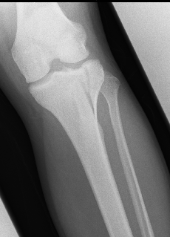
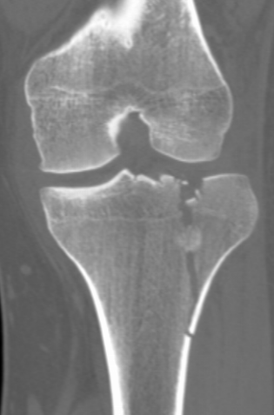
Tibial Plateau Fractures
Xrays: AP/Lateral +/- traction films
CT scan (after ex-fix if appropriate)

Slide 10
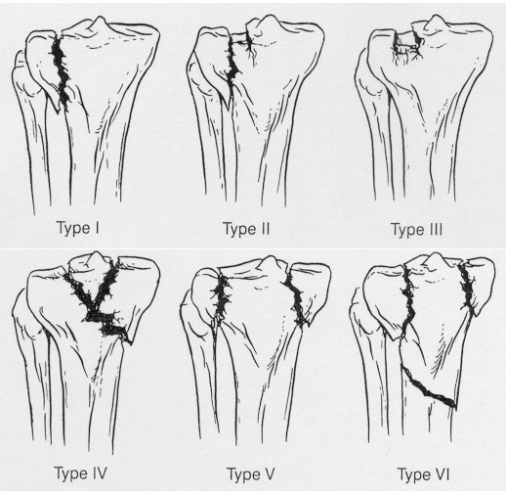
Schatzker Classification of Plateau Fxs
Lower Energy
Higher Energy

Slide 11
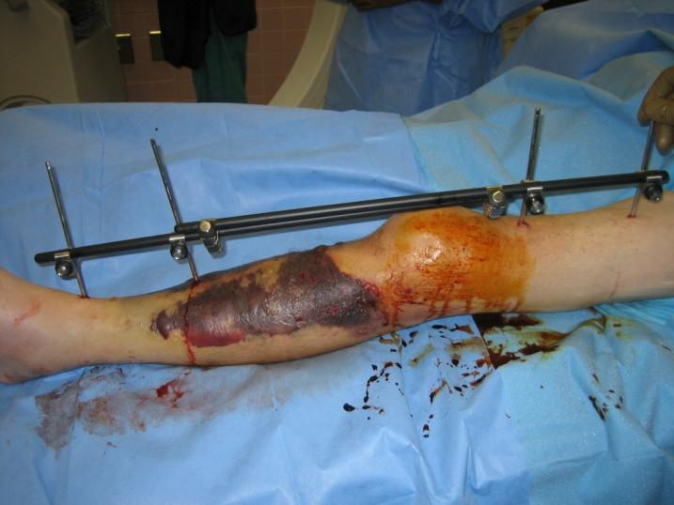
Tibial Plateau Fractures
Treatment
Spanning External Fixator may be appropriate for temporary stabilization and to allow for resolution of soft tissue injuries
Insert blister
Pics of ex-fix here

Slide 12
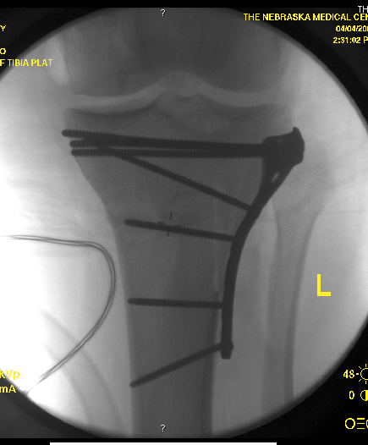
Tibial Plateau Fractures
Treatment
Definitive ORIF for patients with varus/valgus instability, >5mm articular stepoff
Non-operative in non-displaced stable fractures or patients with poor surgical risks

Slide 13
Tibial Shaft Fractures
Mechanism of Injury
Can occur in lower energy, torsion type injury (e.g.,soccer )
More common with higher energy direct force (e.g., car bumper)
Open fractures of the tibia are more common than in any other long bone

Slide 14
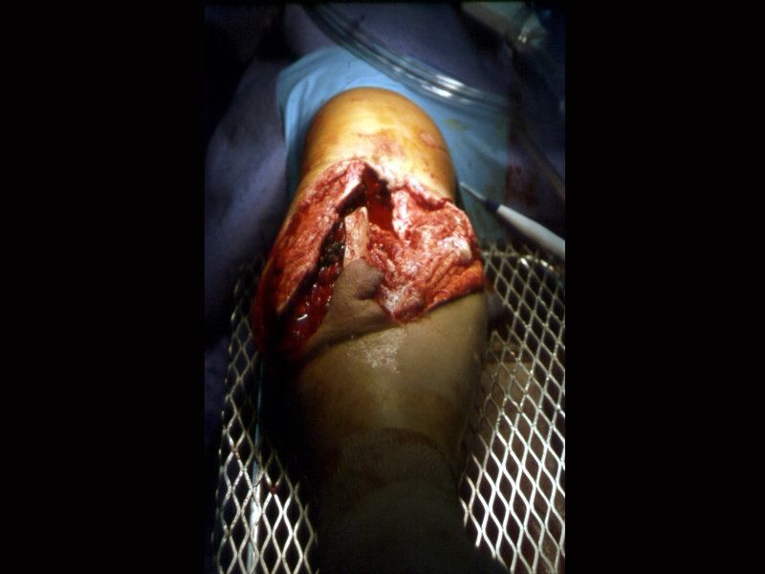
Tibial Shaft Fractures
Open Tibia Fx
Priorities
ABC’S
Associated Injuries
Tetanus
Antibiotics
Fixation

Slide 15
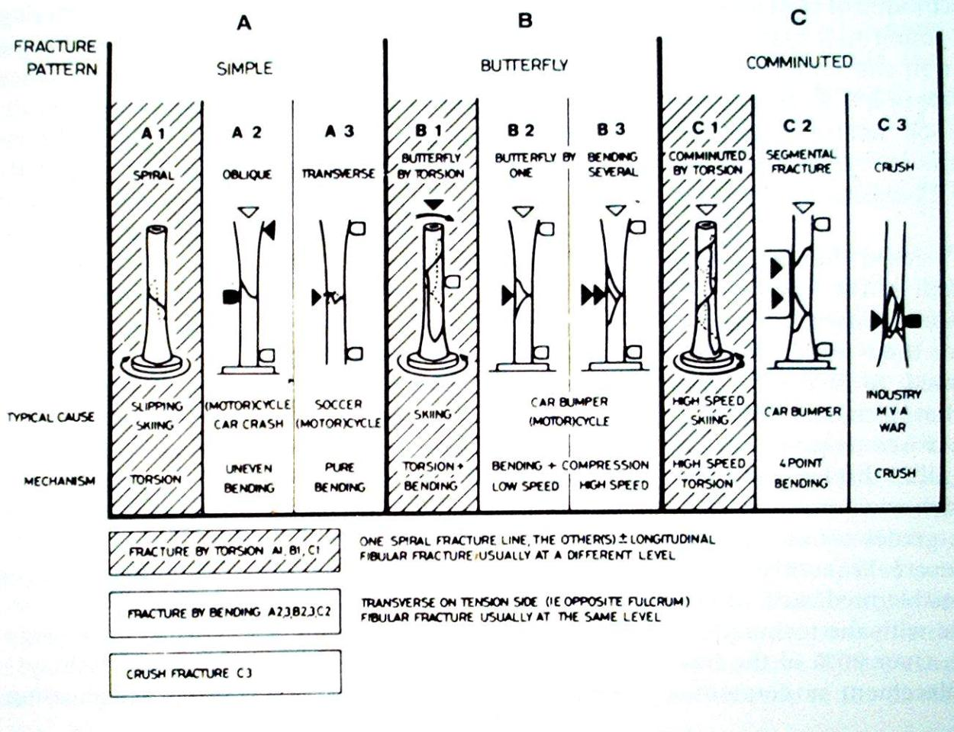
Johner and Wruh’s Classification

Slide 16
Tibial Shaft Fractures
Gustilo and Anderson Classification of Open Fx
Grade 1
<1cm, minimal muscle contusion, usually inside out mechanism
Grade 2
1-10cm, extensive soft tissue damage
Grade 3
3a: >10cm, adequate bone coverage
3b: >10cm, periosteal stripping requiring flap advancement or free flap
3c: vascular injury requiring repair

Slide 17
Tibial Shaft Fractures
Tscherne Classification of Soft Tissue Injury
Grade 0- negligible soft tissue injury
Grade 1- superficial abrasion or contusion
Grade 2- deep contusion from direct trauma
Grade 3- Extensive contusion and crush injury with possible severe muscle injury

Slide 18
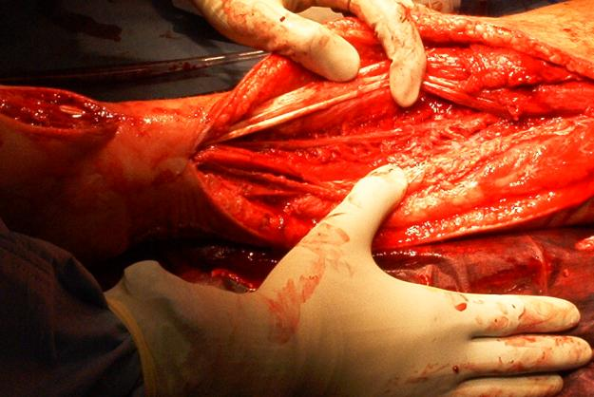
Tibial Shaft Fractures
Management of Open Fx Soft Tissues
ER: initial evaluation → wound covered with sterile dressing and leg splinted, tetanus prophylaxis and appropriate antibiotics
OR: Thorough I&D undertaken within 6 hours with serial debridements as warranted followed by definitive soft tissue cover

Slide 19
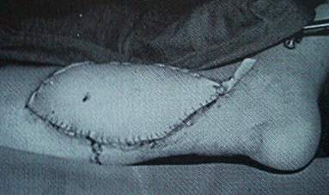
Tibial Shaft Fractures
Definitive Soft Tissue Coverage
Proximal third tibia fractures can be covered with gastrocnemius rotation flap
Middle third tibia fractures can be covered with soleus rotation flap
Distal third fractures usually require free flap for coverage

Slide 20
Tibial Shaft Fractures
Treatment Options
IM Nail
ORIF with Plates
External Fixation
Cast or Cast-Brace

Slide 21
Tibial Shaft Fractures
Advantages of IM nailing
Lower non-union rate
Smaller incisions
Earlier weightbearing and function
Single surgery

Slide 22
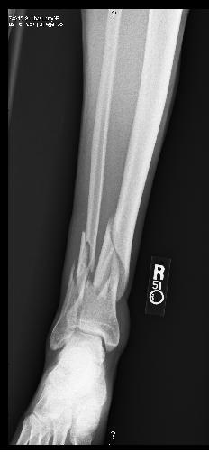
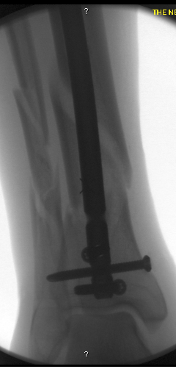
Tibial Shaft Fractures
IM nailing of distal and proximal fx
Can be done but requires additional planning, special nails, and advanced techniques

Slide 23
Tibial Pilon Fractures
Fractures involving distal tibia metaphysis and into the ankle joint
Soft tissue management is key!
Often occurs from fall from height or high energy injuries in MVA
“Excellent” results are rare, “Fair to Good” is the norm outcome
Multiple potential complications

Slide 24
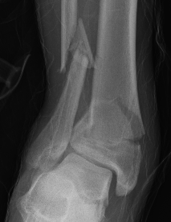
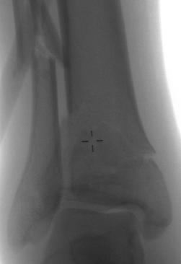
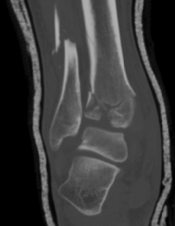
Tibial Pilon Fractures
Initial Evaluation
Plain films, CT scan
Spanning External Fixator
Delayed Definitive Care to protect soft tissues and allow for soft tissue swelling to resolve

Slide 25
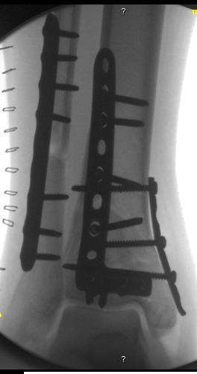
Tibial Pilon Fractures
Treatment Goals
Restore Articular Surface
Minimize Soft Tissue Injury
Establish Length
Avoid Varus Collapse
Treatment Options
IM nail with limited ORIF
ORIF
External Fixator

Slide 26
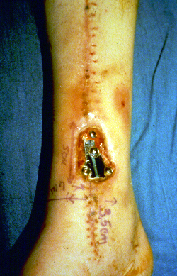
Tibial Pilon Fractures
Complications
Mal or Non-union (Varus)
Soft Tissue Complications
Infection
Potential Amputation
Osteoarthritis esp intraarticular

Slide 27
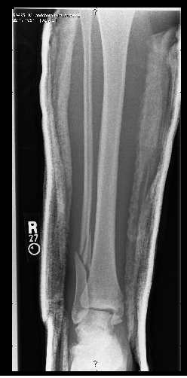
Ankle Fractures
Most common weight-bearing skeletal injury
Incidence of ankle fractures has doubled since the 1960’s
Highest incidence in elderly women
Unimalleolar 68%
Bimalleolar 25%
Trimalleolar 7%
Open 2%

Slide 28
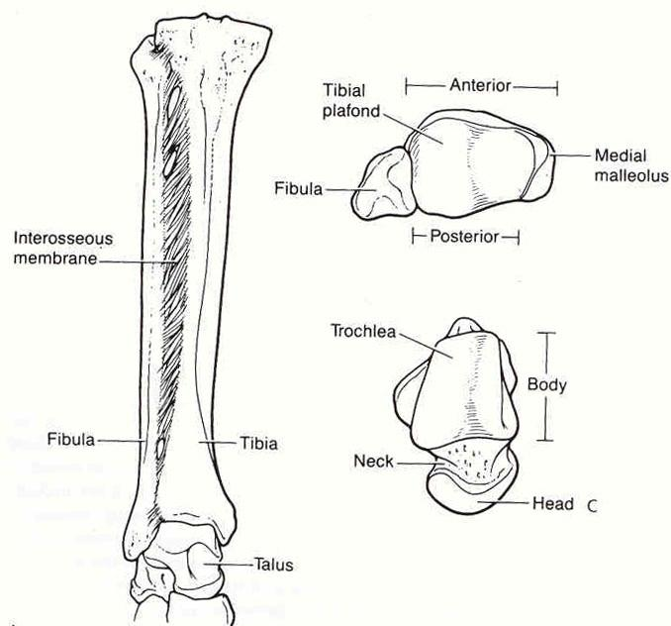
Osseous Anatomy

Slide 29
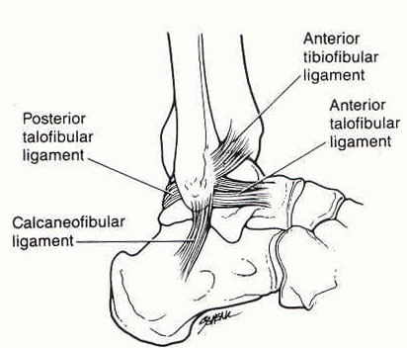
Lateral Ligamentous Anatomy

Slide 30
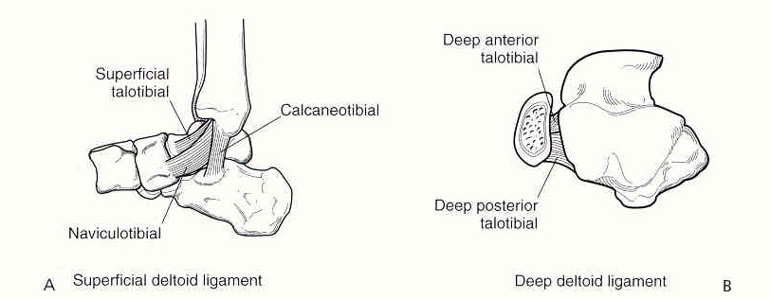
Medial Ligamentous Anatomy

Slide 31
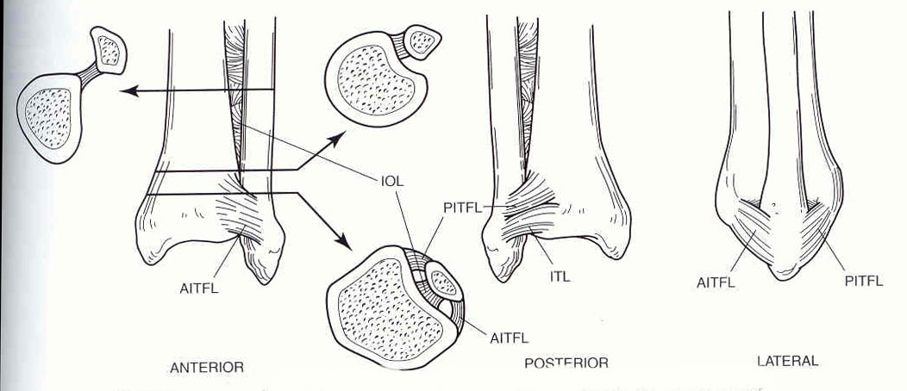
Syndesmosis Anatomy

Slide 32
Ankle Fractures
History
Mechanism of injury
Time elapsed since the injury
Soft-tissue injury
Has the patient ambulated on the ankle?
Patient’s age / bone quality
Associated injuries
Comorbidities (DM, smoking)

Slide 33
Ankle Fractures
Physical Exam
Neurovascular exam
Note obvious deformities
Pain over the medial or lateral malleoli
Palpation of ligaments about the ankle
Palpation of proximal fibula, lateral process of talus, base of 5th MT
Examine the hindfoot and forefoot

Slide 34
Ankle Fractures
Radiographic Studies
AP, Lateral, Mortise of Ankle (Weight Bearing if possible)
AP, Lateral of Knee (Maissaneve injury)
AP, Lateral, Oblique of Foot (if painful)

Slide 35
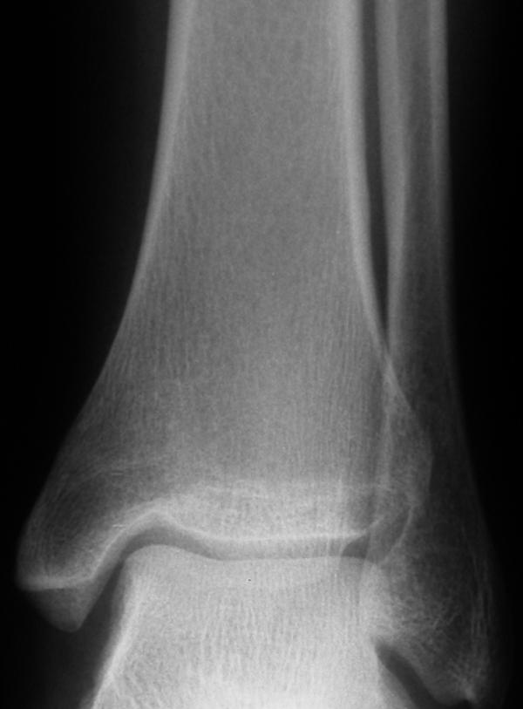
Ankle Fractures
AP Ankle
Tibiofibular overlap
<10mm is abnormal and implies syndesmotic injury
Tibiofibular clear space
>5mm is abnormal - implies syndesmotic injury
Talar tilt
>2mm is considered abnormal

Slide 36
Ankle Fractures
Ankle Mortise View
Foot is internally rotated and AP projection is performed
Abnormal findings:
Medial joint space widening
Talocural angle <8 or >15 degrees (compare to normal side)
Tibia/fibula overlap <1mm

Slide 37
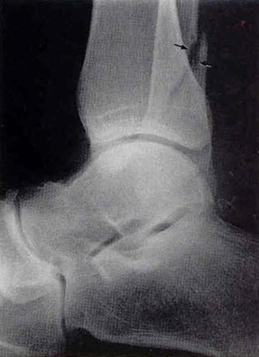
Ankle Fractures
Lateral View
Posterior malleolar fractures
Anterior/posterior subluxation of the talus under the tibia
Displacement/Shortening of distal fibula
Associated injuries

Slide 38
Ankle Fractures
Classification Systems (Lauge-Hansen)
Based on cadaveric study
First word refers to position of foot at time of injury
Second word refers to force applied to foot relative to tibia at time of injury

Slide 39
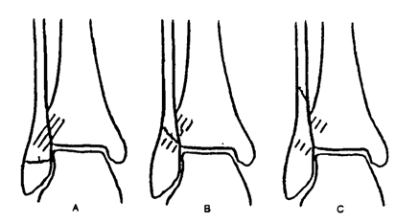
Ankle Fractures
Classification Systems (Weber-Danis)
A: Fibula Fracture distal to mortise
B: Fibula Fracture at the level of the mortise
C: Fibula Fracture proximal to mortise

Slide 40
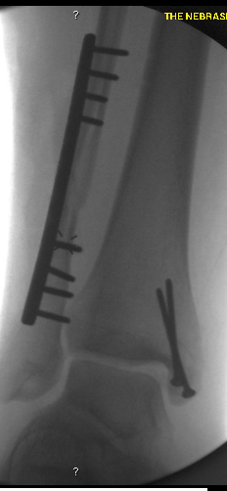
Ankle Fractures
ORIF:
Fibula
Lag Screw if possible + Plate
Confirm length/rotation
Medial Malleolus
Open reduce
4-0 cancellous screws vs. tension band
Posterior Malleolus
Fix if >30% of articular surface
Syndesmosis
Stress after fixation
Fix with 3 or 4 cortex screws

